Slide 1
Pharmacy is ….
“The Art and Science of Manufacturing and dispencing
Drugs and Biologicals to prevent or cure disease there by preserving the Health of Humanity at large”.
2

Slide 2
PHARMACY
Science of Medicines
Manufacuring, Distribution of Medicines for Mankind
Treatment and Prevention of Diseases
3

Slide 3
MEDICINES
Allopathy medicines
Ayurvedic medicines
Biotechnology medicines
Homeopathy medicines
Unani Medicin4 es

Slide 4
Capsule
Injections
Tablet
5

Slide 5
COSMETICS OTC
(Over The Counter)
6

Slide 6
Opportunity
Horizons
BUSINESS (B.Pharm)
Own Industry
Own Distribution Agency
Medical store
JOB (B.Pharm/M.Pharm)
Government Organizations
Pharma Industries
Hospital Pharmacists
Research Institutes
Food & Cosmetic Industries
Clinical Pharmacy
Clinical research org.
Community Pharmacy
Pharma Marketing
Academic jobs (Teaching)
12

Slide 7
INDUSTRIAL PHARMACY
13

Slide 8
Pharma Industry
R & D | Production | Marketing
Formulation | Tablet | Sales Promotion
Quality Assurance | Capsule | Sales executive
Quality Control | Injection | Product development
Bioanalytical | Cosmetics | Manager
Biotechnology | Nutraceuticals
Pharmacology
Drug Discovery
Technology Transfer
Regulatory division |  | 14

Slide 9
CLINICAL RESEARCH
15

Slide 10
HOSPITAL PHARMACY
19

Slide 11
PHARMACIST IN GOVERNMENT SERVICE
Pharmacist in Army, Navy, Air force & Govt. Hospitals
Drug Inspectors –Govt of INDIA and State level
Scientists- Food and Drugs,I.P, ICMR,CIMAP,IICT- laboratories
Govt.University Proffesors and HODs
Oppurtunity to be Selected in UPSC
and State
Public Service Commissions.
Goverment Analysts and Forensic Scientists
Research on tropical diseases, Public health
Govt.Certified Pharmacologist &Toxicologist
Govt. Approved Chemist
Consultants ( Mental health,Addiction, family planning, poisons, self-medication, immunization) ²⁰

Slide 13
Probable MH CET 2020 Exam Dates
Events | Dates 2020
MH CET 2020 Exam | 13th April to 17th April 2020 and 20th April to 23rd April 2020

Slide 14
List of Documents Required for Admission
CET Marksheet
10th & 12th std. Marksheet
School Leaving Certificate
Age, Nationality & Domicile certificate
Aadhar Card Xerox
Income Certificate (Valid Till March 2020)
Caste Certificate
Caste Validity
Non Creamy layer Certificate
Only applicable for reserved category candidates
(SC/ ST/ OBC/SBC/ VJ/ NT/ ESBC

Slide 15
Eligibility
D. PHARMACY- (Course Duration – 2 Years)
HSC Pass
compulsory subjects- Physics and Chemistry
along with Mathematics/ Biology subject.

Slide 16
Eligibility
B. PHARMACY- (Course Duration – 4 Years)
MHT-CET-2020 Examination Appeared with non zero score
HSC Pass with group percentage
Open- 50.00 %
Reserved Category- 45.00%
Compulsory subjects- Physics and Chemistry
Along with Mathematics/ Biology subject.

Slide 17
Shri Balasaheb Mane Shikshan Prasarak Mandal Ambap’s
Ashokrao Mane College of Pharmacy, Peth Vadgaon
Ashokrao Mane Institute of Diploma in Pharmacy,
Womens College of Pharmacy, Peth Vadgaon
Ashokrao Mane Institute of pharmacy, Ambap
Ashokrao Mane Institute of Pharmaceutical Education & Research, Save

Slide 18
Late Shri. Ashokrao Mane
Founder President
Shri. Balasaheb Mane Shikshan Prasarak Mandal, Ambap
A Man Who Strived to up-bring the illiterate mass…

Slide 19
MISSION
Empowerment of nation with knowledgeable pharmacists for Healthy India
VISION
To provide pharmaceutical education par excellence
To foster and disseminate productive research in new and emerging area
To provide community, institutional and industrial pharmacy.
To generate human resource in profession of pharmacy
Notes:
Vision

Slide 20
Approvals & Affiliations
Directorate of Technical Education, Maharashtra State
All India Council for Technical Education
Pharmacy Council of India
Shivaji University, Kolhapur & DBATU, Lonere

Slide 21
About us
Shri. Balasaheb Mane Shikshan Prasarak Mandal was established in 1980 by Late Shri. Ashokrao Mane, Founder President and has been known for its quality education for more than three decades. With 29 Institutions awarding education in the fields of Pharmacy, Engineering, MBA, Polytechnic, Agriculture, as well as Primary School, High schools& Junior Colleges, We are one of the most diversified institutions in Western Maharashtra.

Slide 22
Intake
Ashokrao Mane College of Pharmacy, Peth Vadgaon
D. Pharm. 60
B. Pharm. 100
Womens College of Pharmacy, Peth Vadgaon
D. Pharm. 60
B. Pharm. 100
M. Pharm. 30
Ashokrao Mane Institute of Pharmacy, Ambap
D. Pharm. 60
Ashokrao Mane Institute of Pharmaceutical Education & Research, Save
D. Pharm. 60
B. Pharm. 60
B. Pharm. 100

Slide 23
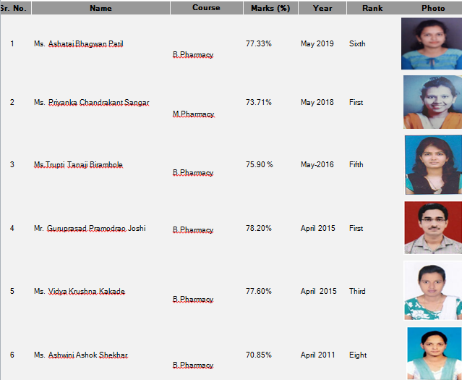
University Rankers

Slide 24
INFRASTRUCTURE
Library : The Institute has spacious & modern library, designed to meet the needs of all the students. Our library is a treasure of many important books in the field of Pharmaceutical technology, Core Chemistry, Basic Sciences, Natural Products, Remington's, several handbooks and reference books.
Laboratories : Well equipped, furnished and Sophisticated Instrumentation Lab. comprising of laboratories including research labs for PG and research lab for Ph. D. studies.
Computer Centre : Upgraded & Well equipped computer facility with P-IV Computers, servers, necessary licensed software, peripheral and high speed broadband internet.
Classroom : Spacious, furnished and well ventilated lecture halls, with teaching aids like LCD projector, OHP. Sophisticated seminar hall for UG and PG students.

Slide 25
WHY To Take Admission in SBMSPM’s Pharmacy Colleges
Excellent academic and extracurricular activities along with research, consultancy and development activities
The state-of-art infrastructure, serene atmosphere, outstanding faculty & the ‘complete’ library
Ideal fusion of theory and practical, with distinct focus on industrial applications.
Professional managed placement cell executing employability development programmes for successful recruitment program
We consider students as a ‘leaders’ who have passion, confidence and discipline.
Exposure to the dynamic faculty and regular interactions with industry experts through guest lectures which help students to gain a perception about the current scenario of Pharma world.
Special employability development workshops are also organized to help the students sharpen their skills to face the corporate world.
Classroom learning is made interesting by highly qualified and experienced faculty through interactions, presentations, brain storming sessions and out bound learning programs.

Slide 26
TRAINING & PLACEMENT CELL
Recruitments in Past
We have deputed our PG Research Students to:
All the communications for Placement related activities are to be addressed to
Vergo Pharma Research, Goa
Ipca Laboratories, Mumbai
Kemwell Pharma, Banglore
Nicholas, Mumbai
Sai Life Sciences, Pune
Blok Pharma, Kolhapur
Training & Placement Cell,
Ashokrao Mane College of Pharmacy, Peth Vadgaon
E Mail: tpo.amcp@gmail.com Contact nos. 0230-2471360/61

Slide 27
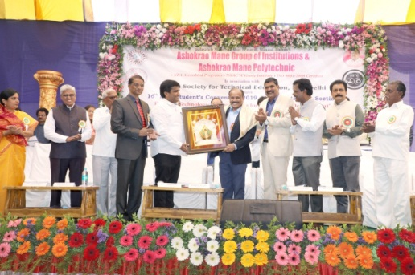
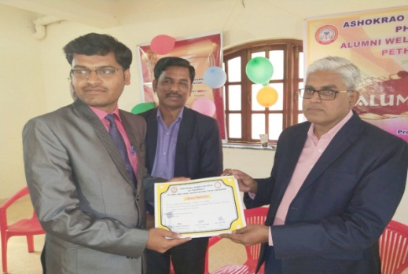
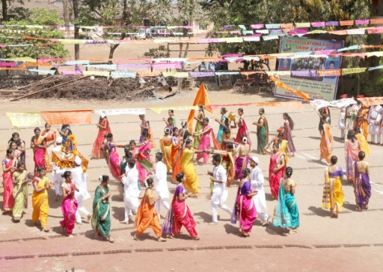
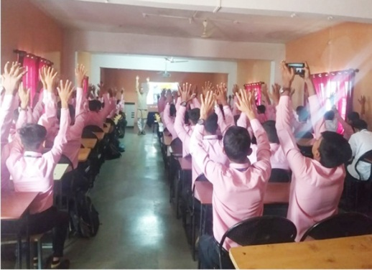
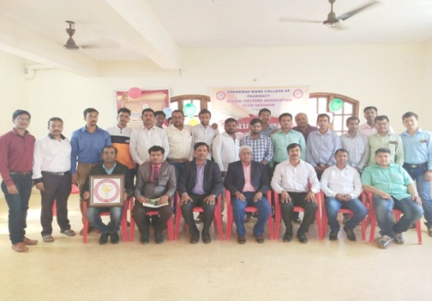
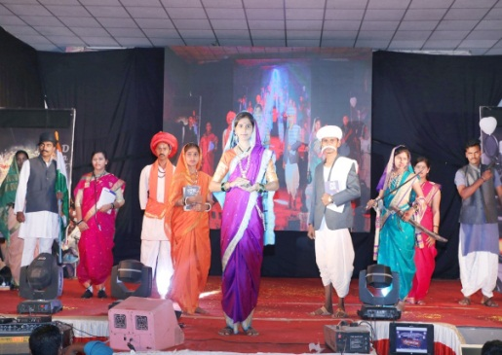
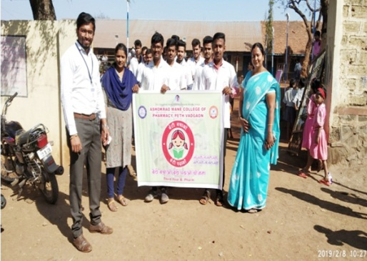
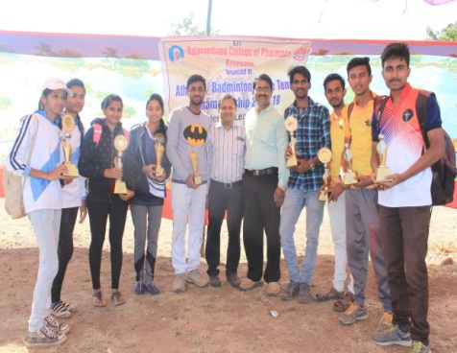
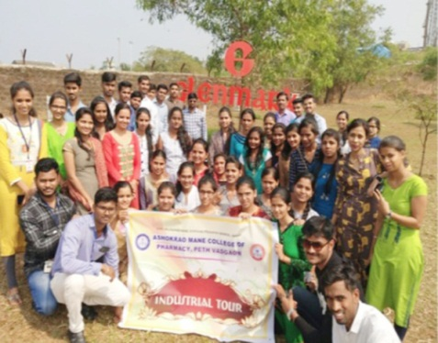
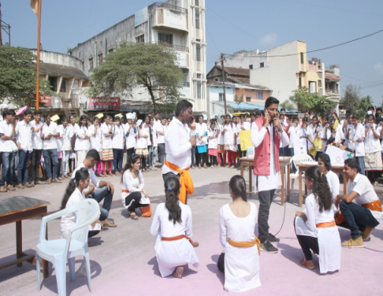
HAPPENINGS
Annual Cultural Event – ‘Kshitij’
Lead College Programmes I
ntercampus & Intercollege Sports
Personality Development Programs
Seminars by Industrial Experts
Quiz & Debate Competition
Industrials Visits
Outdoor Conferences
NSS Camp
Teacher’s Day
Pharmacist’s Day
Fresher’s Welcome Ceremony
Farewell Programme
Parent-Teacher Meet

Slide 28
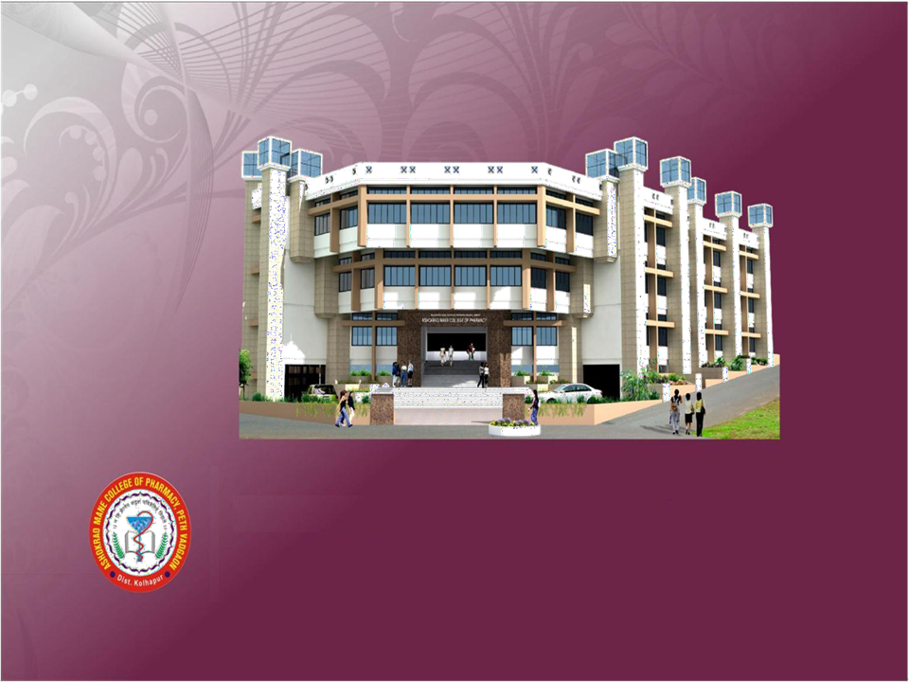
Shri Balasaheb Mane Shikshan Prasarak Mandal, Ambap's
Pharmacy Colleges
For more details Install our APP
amcoph.org/apps/amcoph.apk
Contact. No. 7720004393/ 8888863206
Shri Balasaheb Mane Shikshan Prasarak Mandal, Ambap's
Peth Vadgaon, Tal. Hatakanangale, Dist. Kolhapur,
Maharashtra 416 112
Phone: 0230-2471360/61 E
Mail: tpo.amcp@gmail.com
Web: www.amcoph.org

